Slide 1
Spark Vs MapReduce
CS5229
Big Data Analytics Technologies
Seedin TM
248375F

Slide 2
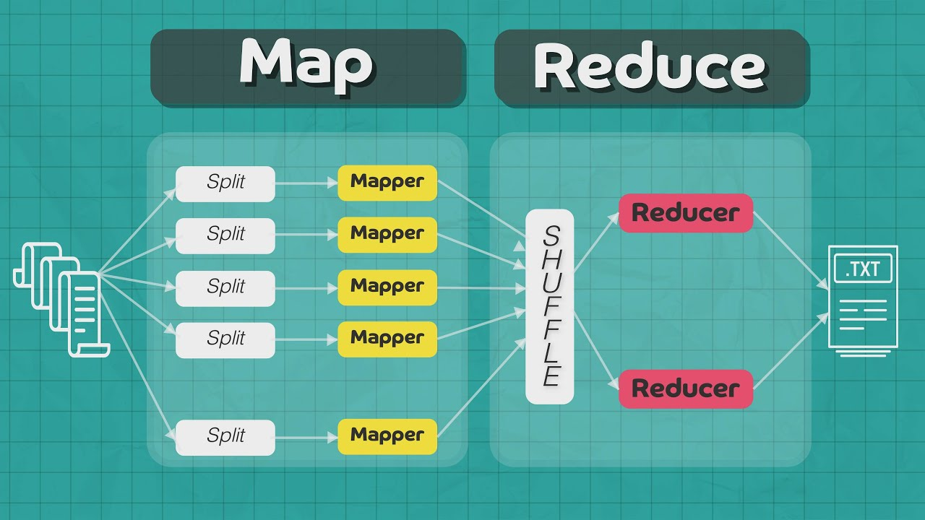
Introduction to MapReduce
What is MapReduce?
A programming model and processing technique designed for distributed computing.
Originated from Google's model for processing large datasets in parallel.
Key Concepts:
Map Function: Breaks the problem into smaller tasks and processes them independently.
Reduce Function: Aggregates the results from the map tasks.
Usage:
Efficiently processes and generates large-scale data in a parallel and distributed manner.

Slide 3
Introduction to Apache Spark
What is Apache Spark?
An open-source, fast, and general-purpose distributed computing system.
Developed to overcome limitations of MapReduce and enhance processing capabilities.
Key Features:
In-Memory Processing: Stores intermediate data in memory, reducing the need for disk I/O.
Fault Tolerance: Reliable and fault-tolerant data processing.
Programming Languages:
Supports multiple languages, including Scala, Java, Python, and R.
Usage:
Ideal for iterative algorithms, machine learning, and real-time data processing.

Slide 4
Demo
Task 1: Loading Data
Task 2: Processing Data
Task 3: Applying Queries
Task 4: Visualizing with Comparison

Slide 5
Comparison of MapReduce and Apache Spark: Ease of Use
MapReduce:
Programming Language: Primarily Java.
Learning Curve: Steeper learning curve due to lower-level abstractions.
Apache Spark:
Programming Language: Supports multiple languages (Scala, Java, Python, etc.).
Learning Curve: Relatively lower learning curve with higher-level abstractions.

Slide 6
Comparison of MapReduce and Apache Spark: Fast Processing
MapReduce:
Disk-Based Processing: Typically relies on disk-based storage for intermediate data.
Performance: Slower due to frequent disk I/O operations.
Apache Spark:
In-Memory Processing: Utilizes in-memory storage for intermediate data.
Performance: Generally faster than MapReduce, especially for iterative algorithms.

Slide 7
Conclusion
Apache Spark often proves advantageous with its ease of use and faster processing.
Evaluate based on project needs and the trade-offs between simplicity and performance.

Slide 8
Thank You

